Slide 1

OLA Data Analyst Project
Comprehensive analysis of 100,000 ride bookings in Bengaluru using Python, SQL, and Power BI
Prepared by: Parth Shethia

Slide 2


Project Overview
Dataset Scale
Tools & Technologies
100,000 bookings analyzed across one month in Bengaluru
Python (Pandas), SQL, Power BI for end-to-end analysis
Business Focus
62% success rate with detailed cancellation and revenue insights

Slide 3
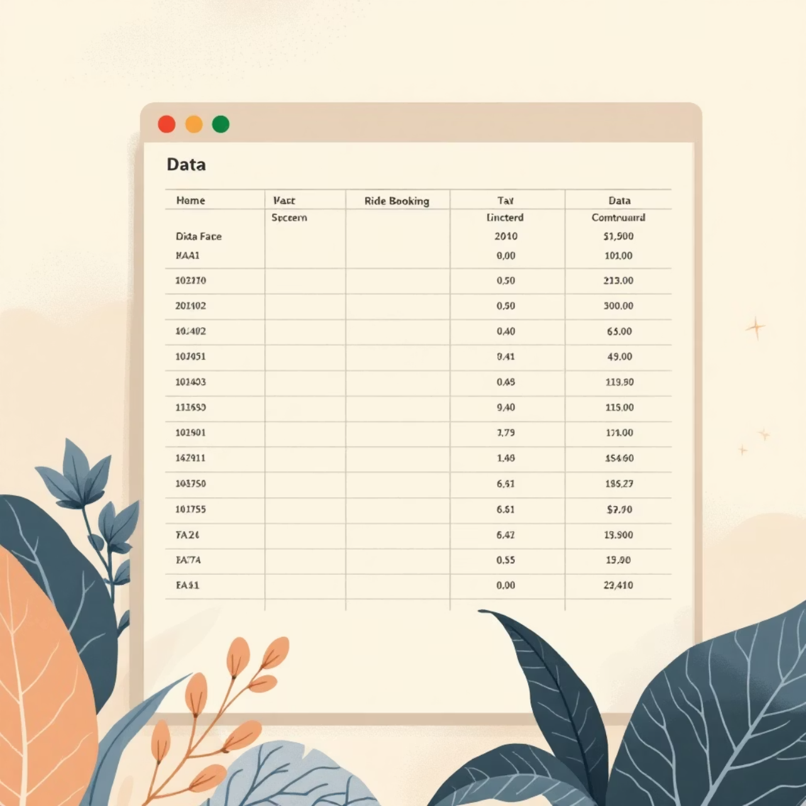

Data Generation & Structure
Key Data Points
19 comprehensive columns tracking every ride aspect
7 vehicle types from bikes to Prime SUVs
50 pickup/drop locations across Bengaluru
Multiple cancellation and rating metrics
Business Constraints
Customer cancellations under 7%
Driver cancellations under 18%
Incomplete rides below 6%
70% orders under ₹500

Slide 4
Data Cleaning Process
01
02
03
Data Inspection
Column Optimization
Standardization
Loaded Excel data and identified structure, datatypes, and missing values
Removed irrelevant columns and merged Date/Time into booking_datetime
Unified booking outcomes, cancellation reasons, and categorical fields
04
05
Data Validation
Export & Import
Applied business rules, converted numeric types, removed hidden characters
Exported clean CSV and imported into MySQL for analysis

Slide 5

SQL Analysis Framework
10 SQL Views Created
Successful bookings, ride distances, cancellations, top customers, ratings analysis, payment methods, and revenue calculations
Performance Optimization
Views improve query speed and enable seamless Power BI integration for real-time insights

Slide 6

Booking Performance Snapshot
103K
64K
29K
Total Bookings
Successful Rides
Cancelled Bookings
One month of ride data
62% completion rate
28% cancellation rate
Nearly 1 out of every 3 bookings does not convert into a completed ride, directly impacting revenue and customer experience.

Slide 7

Cancellation Deep Dive
Customer Cancellations
Driver Cancellations
Personal & vehicle issues
Driver not moving to pickup
Customer-related problems
Driver requested cancellation
Passenger policy violations
Change of travel plans
Insight: Driver reliability remains critical contributor
Wrong pickup address
Insight: Operational execution issues, not lack of customer intent

Slide 8
Service Quality Metrics
4.0/5
4.0/5
Driver Ratings
Customer Ratings
Consistent across vehicle types (3.98-4.01)
Acceptable quality with room for improvement (3.99-4.01)
Ratings indicate acceptable service but highlight scope to achieve premium 4.5+ experience.

Slide 9





Strategic Recommendations
Reduce Cancellations
Track driver movement, penalize cancellation requests, auto-reallocate delayed drivers
Promote Digital Payments
Incentivize UPI adoption to reduce cash dependency and operational risk
Optimize Vehicle Strategy
Promote autos for short trips, premium pricing for longer Prime category rides
Improve Service Quality
Focus on driver training and pickup punctuality to raise ratings beyond 4.5
Retain High-Value Customers
Introduce loyalty programs to stabilize revenue from repeat customers

